Slide 1
Disaster Tweet Detection System
Submitted By: Saket Rai
Technology: Python, Flask, Machine Learning
Algorithm: Logistic Regression

Slide 2
Introduction:-
Developed a Disaster Tweet Detection System using Machine Learning and NLP.
Used a dataset of 10,000 labeled disaster tweets.
Applied TF-IDF Vectorization for text feature extraction.
Trained the model using Logistic Regression.
Developed a Flask-based Web Application for real-time tweet classification.
Displays prediction result, confidence score, probability values, tweet statistics, and pie chart visualization.
Designed a user-friendly interface using HTML, CSS, Bootstrap, and JavaScript.

Slide 3
Problem Statement:-
Large numbers of tweets are posted during disasters.
Manual identification of disaster-related tweets is slow and inaccurate.
Similar words in normal tweets create confusion during classification.
A fast and automated tweet classification system is required.
This project solves the problem using Machine Learning, TF-IDF, and a Flask Web Application.

Slide 4
Project Objectives
Develop a Machine Learning model to classify tweets as Disaster or Non-Disaster.
Preprocess tweet text and extract meaningful features using Natural Language Processing (NLP) and TF-IDF.
Train and evaluate the Logistic Regression model for accurate tweet classification.
Build a Flask-based web application for real-time disaster tweet prediction.
Display prediction results, confidence score, probability values, and visualizations to help users understand the output.
Provide a simple, fast, and user-friendly interface for detecting disaster-related tweets.

Slide 5
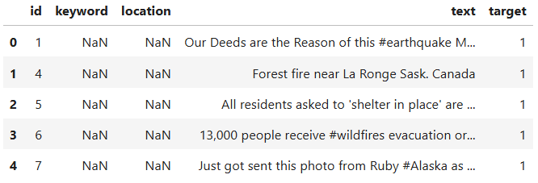
Dataset Information
Dataset Size: 10,000 Tweets
Input: Tweet Text
Features: id, keyword, location, text, target
Output: Disaster (1) Non-Disaster (0)
df.head()

Slide 6
Data Preparation
Removed URLs, special characters, punctuation, and unnecessary spaces from the tweet text.
Converted all text to lowercase and removed stopwords to improve text quality.
Split each tweet into individual words (tokens) for text analysis.
Converted target labels into numerical values (0 = Non-Disaster, 1 = Disaster).
Applied TF-IDF Vectorization to convert text into numerical feature vectors.
Divided the dataset into training and testing sets for model training and performance evaluation.

Slide 7
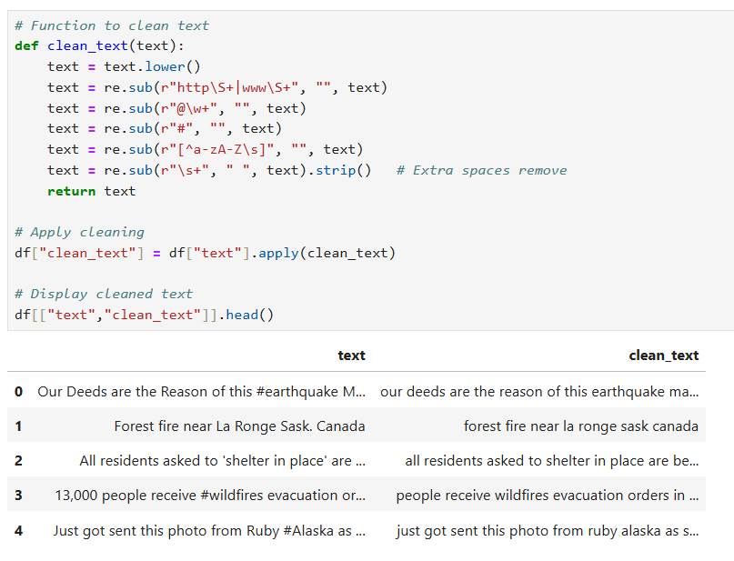
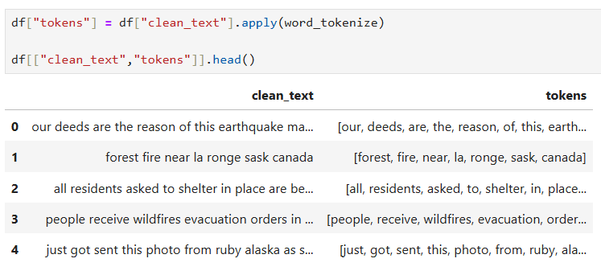
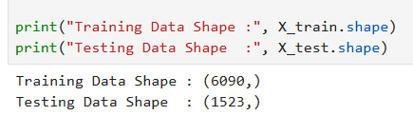
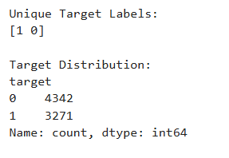
Cleaning the tweet
Tokenize the Text
Split Dataset

Slide 8
Feature Engineering
TF-IDF Vectorization: Converted tweet text into numerical features.
Word Frequency: Measured the importance of words in each tweet.
Feature Matrix: Created numerical input for the Machine Learning model.
Text Representation: Captured meaningful information from tweet text.
Feature Selection: Used relevant features for accurate classification.
Model Input: Prepared features for the Logistic Regression model.

Slide 9
Model Development
Trained the Logistic Regression model using the training dataset.
Used TF-IDF features as input for classification.
Classified tweets into Disaster and Non-Disaster.
Generated prediction and probability scores.
Evaluated model performance using standard metrics.
Saved the trained model as a Pickle (.pkl) file.

Slide 10
Performance Evaluation
Evaluated the model using the testing dataset.
Measured Accuracy, Precision, Recall, and F1-Score.
Generated the Confusion Matrix to analyze predictions.
Plotted ROC Curve and Precision–Recall Curve.
Compared the model performance to select the best classifier.
Achieved reliable performance for disaster tweet classification.

Slide 11
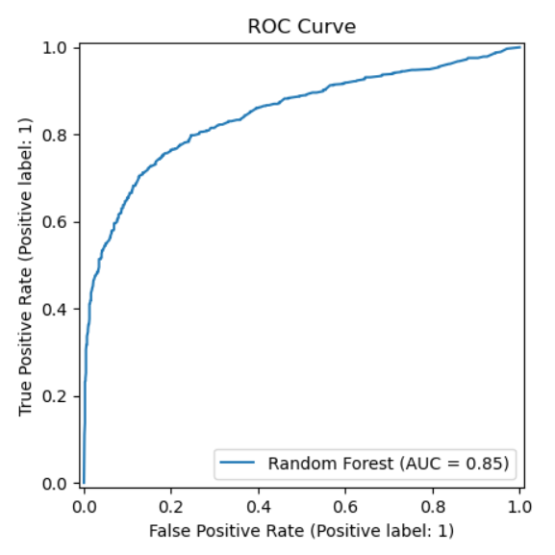
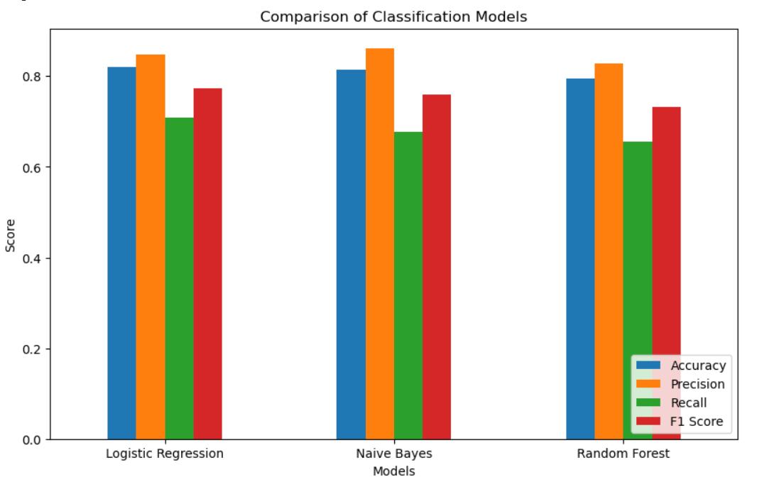
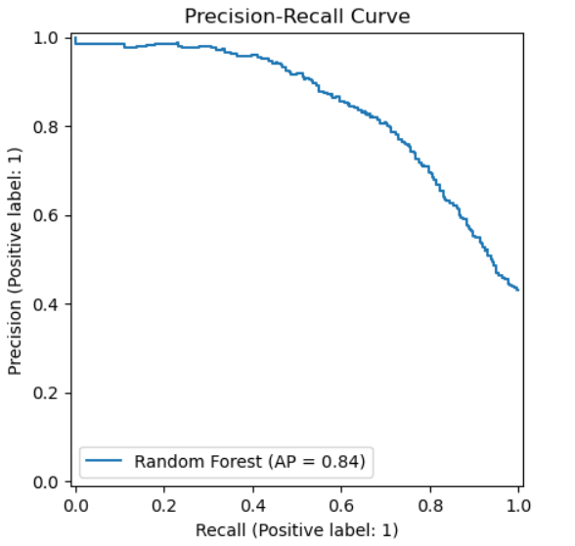

Slide 12
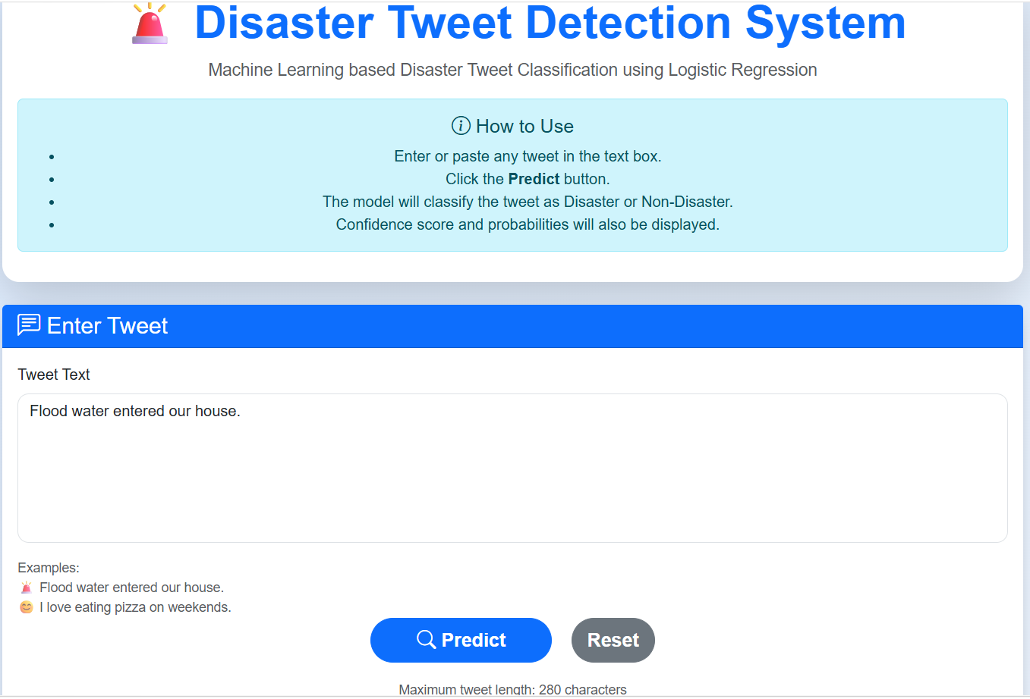
Web Application using Flask Deployment
Developed using Flask framework.
Created a responsive user interface with HTML, CSS, and Bootstrap.
Accepts tweet input from the user.
Displays prediction, confidence score, and probability values.
Shows tweet statistics and pie chart visualization.
Integrated the trained Logistic Regression model using Pickle files.

Slide 13
Prediction Output
Predicts whether a tweet is Disaster or Non-Disaster.
Displays the confidence score for each prediction.
Shows disaster and non-disaster probability values.
Calculates word count and character count of the tweet.
Visualizes prediction using a pie chart.
Provides results instantly through the Flask web application.

Slide 14
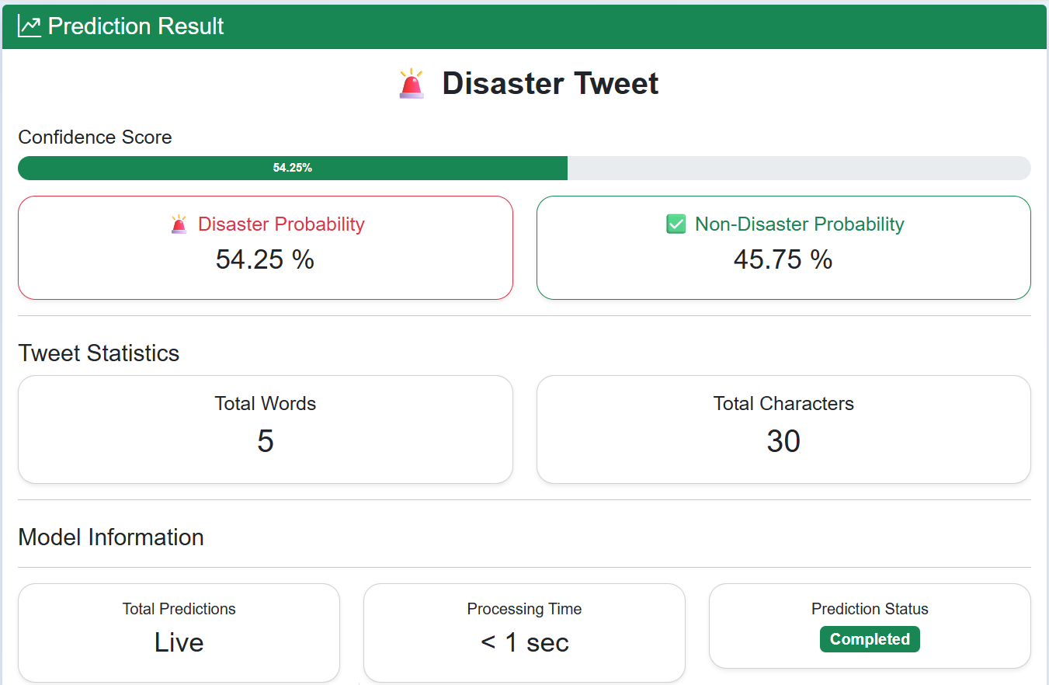
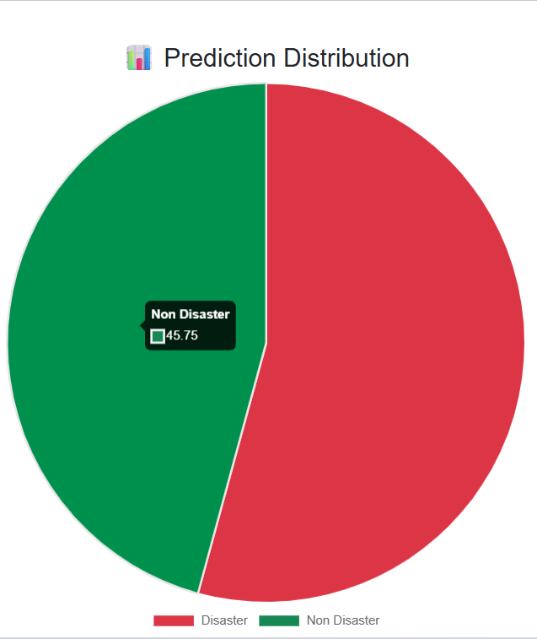
Prediction Output:-

Slide 15
Technologies Used
Python – Programming Language
Pandas – Data Processing
NumPy – Numerical Computation
Scikit-learn – Machine Learning
TF-IDF Vectorizer – Feature Extraction
Logistic Regression – Classification Algorithm
Flask – Web Framework
HTML & CSS – User Interface Design
Bootstrap 5 – Responsive UI
Chart.js – Pie Chart Visualization
Joblib – Model Serialization (.pkl)

Slide 16
Project Features
Real-time Prediction
Confidence Score
Probability Analysis
Tweet Statistics
Pie Chart Visualization
Responsive UI
Flask Deployment
Pickle Model Integration

Slide 17
Conclusion
Successfully developed a Disaster Tweet Detection System using Machine Learning and NLP.
The Logistic Regression model accurately classifies tweets as Disaster or Non-Disaster.
A Flask-based web application was developed for real-time tweet prediction.
The application provides confidence score, probability analysis, and visualizations for better understanding.
This project demonstrates how Machine Learning can support faster disaster detection and improve emergency response.

